Slide 1
Topic : About Python Language
Written By: Pooja Mishra

Slide 2
Contents
Which one language I choose?
Which company using python ?
Features of python
Why We use Python ?
History of Python
Application of Python
Benefits of Python
Python installation
Python simple code
Future of python is Bright or Dull?
Online Practice for Python
Conclusion

Slide 3
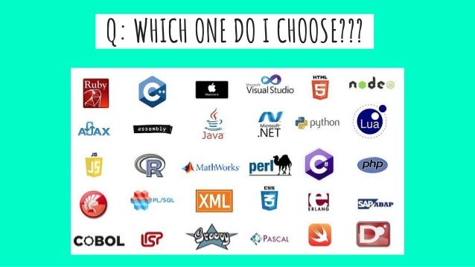
Which one language I choose?

Slide 4
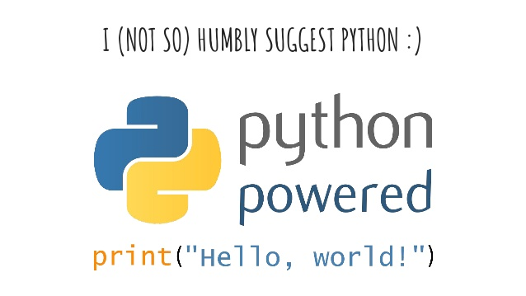

Slide 5
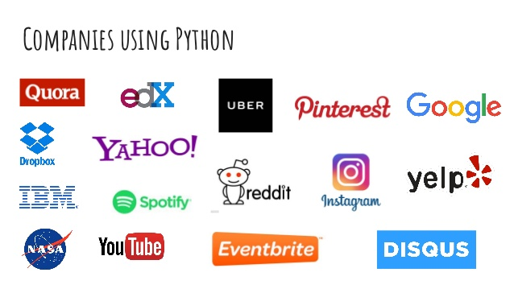
Some top companies using pything .

Slide 6
Top Company
1:Google: The company that needs no introduction, Google. Its video platform Youtube is all written on python!
2: Instagram: An image sharing platform was a simple language developed on Django (Python framework) before it was acquired by Facebook.
3: Netflix: The video streaming platform offer suggestions to its users constantly. Do you know what makes this possible. Yes, it’s THE PYTHON!

Slide 7
Cont.
Companies using python #4: Facebook: According to the official blog from facebook, 21% of facebook codebase is based on Python.
Do you know why so many top-notch companies choose to use python? Do you know what actually makes python so successful and ready for future? It’s the support it provides to the latest technologies which have brilliant future prospects.

Slide 8
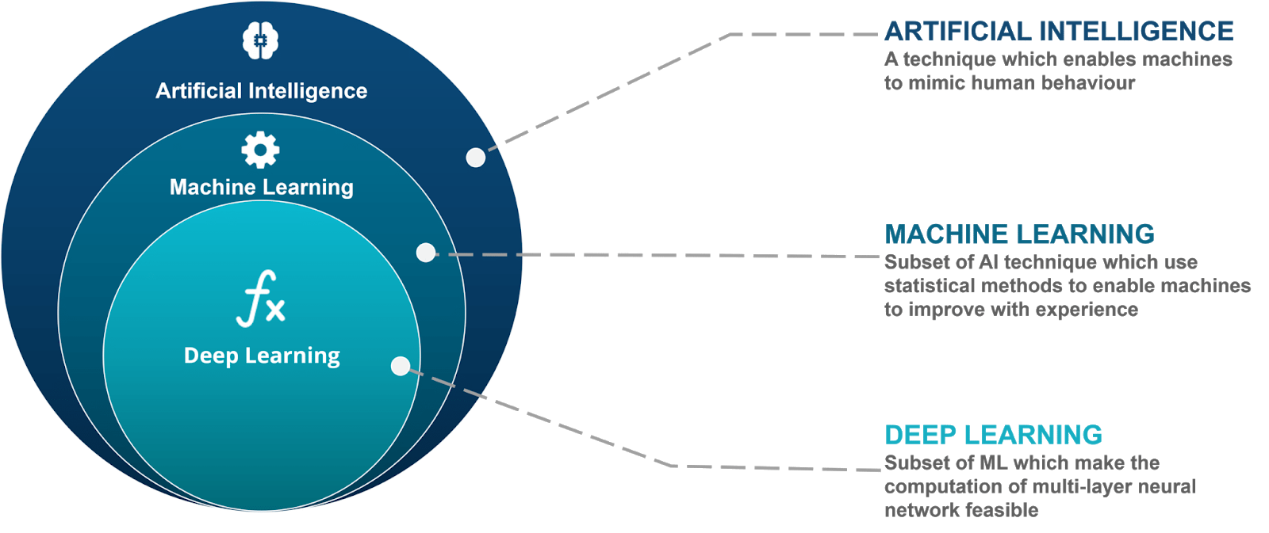
Some tool available in Python

Slide 9
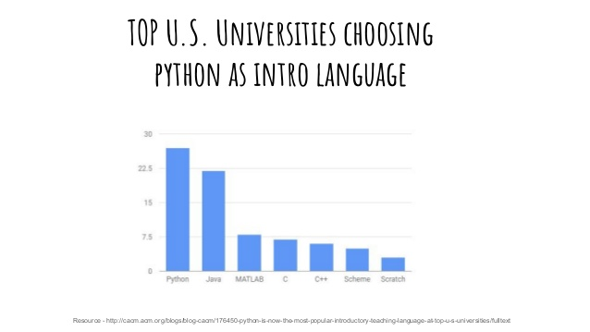
Top universities choosing

Slide 10
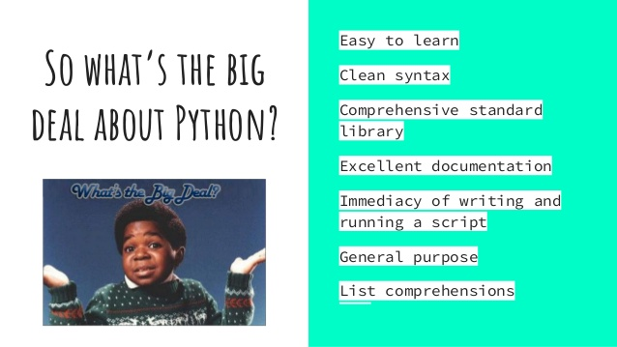
Features of Python

Slide 11
History Of Python
Python is a widely used general-purpose, high-level programming language.
It was initially designed by Guido van Rossum in 1991 and developed by Python Software Foundation.
It was mainly developed for emphasis on code readability, and its syntax allows programmers to express concepts in fewer lines of code.

Slide 12
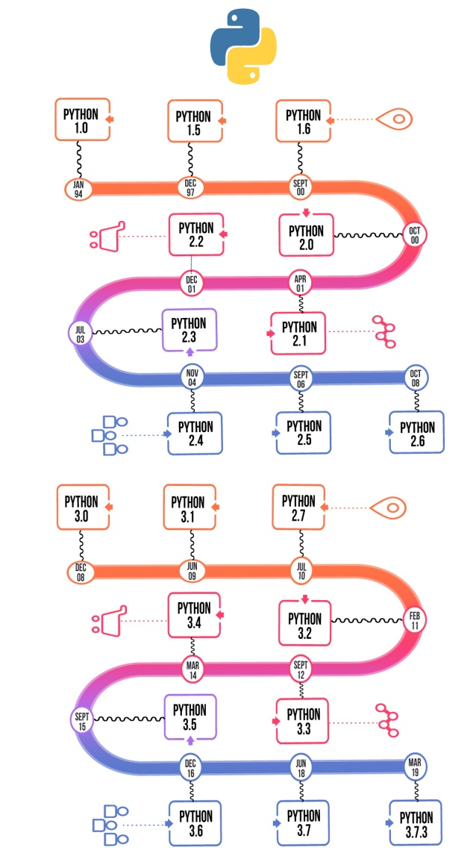
History Of Python

Slide 13
Benefits of Python
It’s free!
Capable of both backend and frontend development
Cross-platform language
Strong support of the community
Provides a plethora of tools
Fewer codes

Slide 14
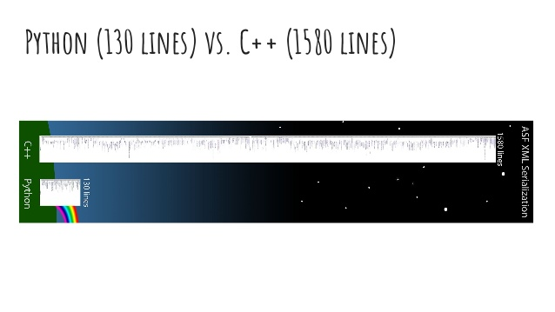

Slide 15
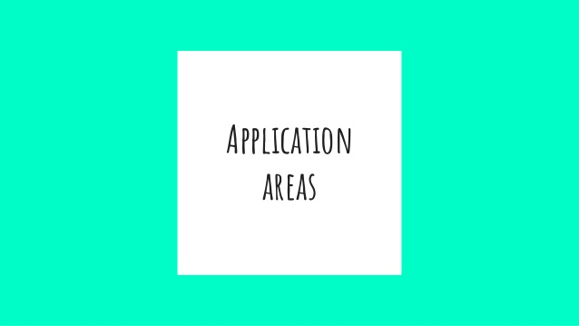

Slide 16
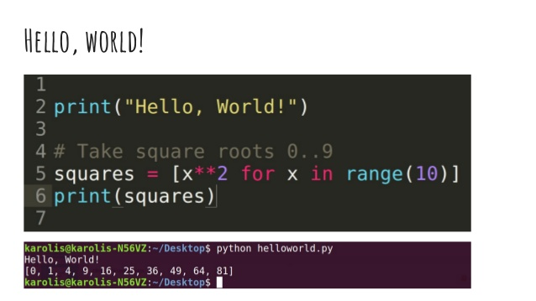
Simple Code (syntax)

Slide 17
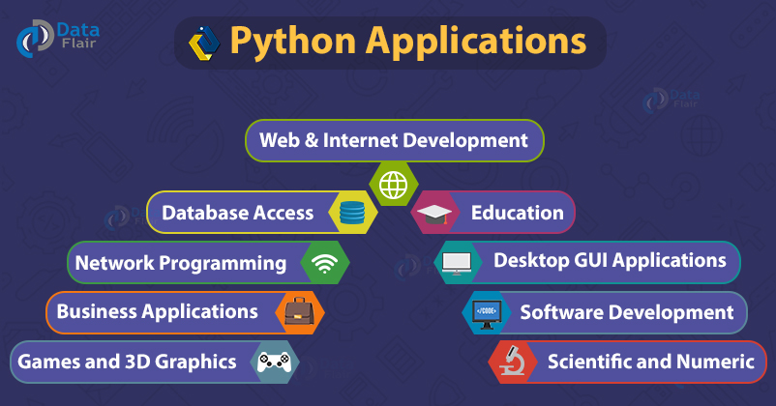
Application

Slide 18
Cont..
Game Development
Machine Learning and Artificial Intelligence
Data Science and Data Visualization
Desktop GUI
Web Scraping Applications
Business Applications
Audio and Video Applications
CAD Applications
Embedded Applications

Slide 19
Web Development
Python can be used to make web-applications at a rapid rate. Why is that? It is because of the frameworks Python uses to create these applications. There is common-backend logic that goes into making these frameworks and a number of libraries that can help integrate protocols such as HTTPS, FTP, SSL etc. and even help in the processing of JSON, XML, E-Mail and so much more.
Some of the most well-known frameworks are Django, Flask, Pyramid. Why use a framework? The security, scalability, convenience that they provide is unparalleled compared to starting the development of a website from scratch.

Slide 20
Game Development
Python is also used in the development of interactive games. There are libraries such as PySoy which is a 3D game engine supporting Python 3, PyGame which provides functionality and a library for game development. Games such as Civilization-IV, Disney’s Toontown Online, Vega Strike etc. have been built using Python.

Slide 21
Machine Learning and Artificial Intelligence
Machine Learning and Artificial Intelligence are the talks of the town as they yield the most promising careers for the future. We make the computer learn based on past experiences through the data stored or better yet, create algorithms which makes the computer learn by itself. The programming language that mostly everyone chooses? It’s Python. Why? Support for these domains with the libraries that exist already such as Pandas, Scikit-Learn, NumPy and so many more.

Slide 22
Cont..
Learn the algorithm, use the library and you have your solution to the problem. It is that simple. But if you want to go the hardcore way, you can design your own code which yields a better solution, which still is much easier compared to other languages.

Slide 23
Data Science and Data Visualization
Data Science and Data Visualization
Data is money if you know how to extract relevant information which can help you take calculated risks and increase profits. You study the data you have, perform operations and extract the information required. Libraries such as Pandas, NumPy help you in extracting information.
You can even visualize the data libraries such as Matplotlib, Seaborn, which are helpful in plotting graphs and much more. This is what Python offers you to become a Data Scientist.

Slide 24
Desktop GUI
Python can be used to program desktop applications. It provides the Tkinter library that can be used to develop user interfaces. There are some other useful toolkits such as the wxWidgets, Kivy, PYQT that can be used to create applications on several platforms.
You can start out with creating simple applications such as Calculators, To-Do apps and go ahead and create much more complicated applications.

Slide 25
Web Scraping Applications
Python can be used to pull a large amount of data from websites which can then be helpful in various real-world processes such as price comparison, job listings, research and development and much more.

Slide 26
Installation Of Python
Download the Python 3 Installer
Open a browser window and navigate to the Download page for Windows at python.org.

Slide 27
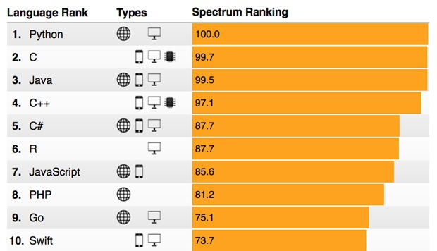
Ranking..

Slide 28
Future of Python Language: Bright or Dull?
In contemporary times, 126,424 websites are made using the python programming language. Many top-notch companies have developed successful apps by using it. This is why it is considered the language of today and the future.
Python might not had bright years in the past since its launch in 1991 but it has seen a constant and remarkable trend of growth in the 21st century. This stack overflow graph of major programming languages' growth clearly depicts the steady upliftment of the PYTHON!

Slide 29
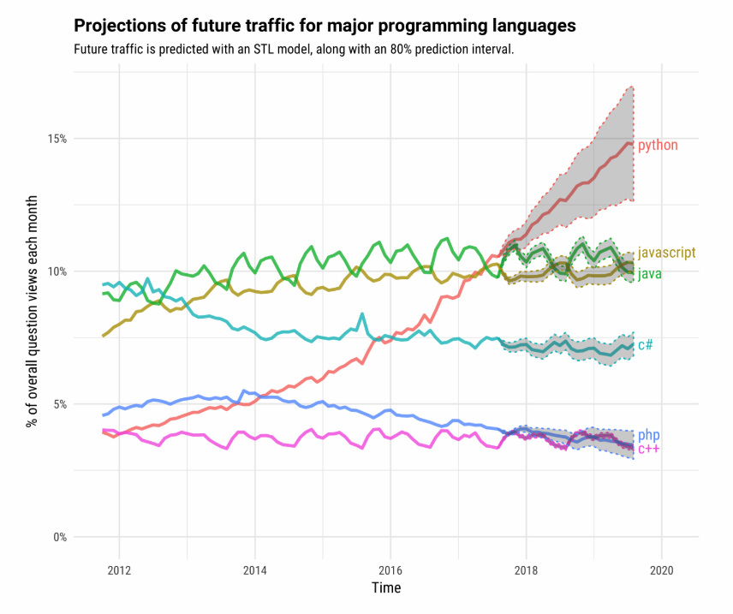
Growth of python in ( till 2020)

Slide 30
Cont..
The growth rate of python was not something easy to achieve. There are various attributes of this programming tool which has provided it with an amazing successful journey. Python has a major role in the latest technologies of current and future times like ML and AI.
Looking at the bright scope of these technologies which are heavily supported by python codes, many people wonder, “Is python the future of programming?

Slide 31
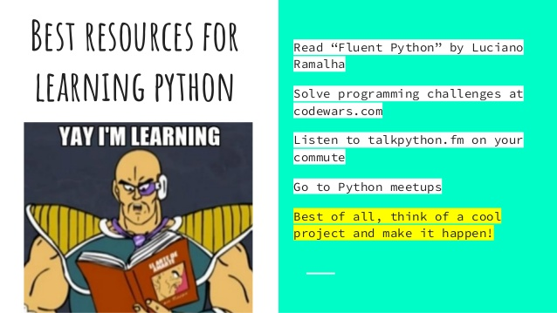

Slide 32
Online website for practice
Hackerrank
Hackerearth
Codeninja
Code academy
Techgig
Codingbat
W3resource

Slide 33
Conclusion
the awesome benefits and performance of python and its libraries is working as the root for its constant growth. This foundation is so strong, that almost all top-notch companies are using this language in their codebase.
Moreover, the future technologies like AI and its subsets, big data and networking ensures a bright future for this programming tool. It's a quite secure and cost-effective programming language.
This allures millions of small and mid-sized businesses to get their software developed by using python.

Slide 34
Thank You

